Slide 1


Northeast Natural Gas Market Outlook
Northeast Natural Gas Market Outlook
Ron Denhardt
Vice President, WEFA Energy Services
October 2000
Ron Denhardt
Vice President, WEFA Energy Services
September 2000

Slide 2
Overview
AECO - Henry Hub Basis
Midwest Flows and Basis
Northeast Demand, Pipeline Capacity and Basis

Slide 3
AECO Basis Formation Before Alliance
Western Canada Price Determination
Before Alliance
0.4
Marginal AECO Price
0.2
Available Supply For Export
0
Decontr
-0.2
Firm
acted:
Henry Hub - AECO Basis
Short-
($US/Mmbtu)
Contracts
Firm
Firm Contracts to
Term
-0.4
to NE
Contracts
U.S. Midwest
Services
to Eastern
-0.6
Canada
Firm Contracts to
-0.8
Western U.S.
-1
0
1
2
3
4
5
6
7
8
9
10
11
12
13
14
15
Bcfd

Slide 4
During the spring and summer of 2000 AECO - Henry Hub basis widened because:
Strong gas demand in Southern California caused the Northern - Southern California basis to widen
Eastern Canadian storage was not filled because of high prices
Maintenance on Nova system
Additional supplies coming on from Fort Liard area in BC

Slide 5
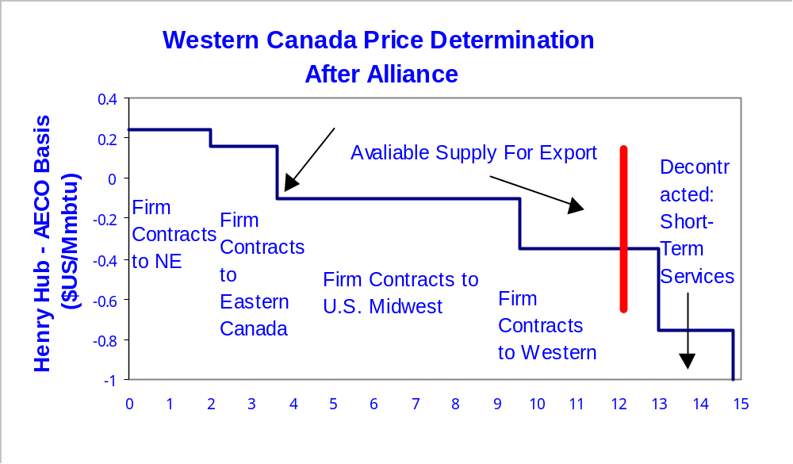
Alliance addition of 1.6 Bcfd to Midwest will be greater than 1.1 Bcfd de-contracting on TCPL
Bcfd

Slide 6
Major projects are to move gas from Midwest (14.5 Bcfd) to Northeast (11.6 Bcfd)
Eastern Canada
3.4 Bcfd
New England
1.7 Bcfd
Vector
Supply Link
Independence
Market Link
Millennium
Chicago
Dawn
NY
Leidy
Joliet
Midwest
14.5 Bcfd
Middle Atlantic
6.5 Bcfd

Slide 7
Even with Alliance there will be net flows from the Gulf to the Midwest
Net Flow (Bcfd)
  Annual 11.5
  Summer 9.8
  Winter 12.2
Canada + SW 6.8
Alliance 1.6 Bcfd
Total with Alliance 8.4 Bcfd
Net Gulf 1.4 Bcfd (9.8 - 8.4)
Canada
3.7 Bcfd
3.5 Bcfd
96%
Capacity
Flow
Utilization
Southwest
4.7 Bcfd
3.3 Bcfd
70%
Gulf
7.3 Bcfd
4.7 Bcfd
68%

Slide 8
Net flows to western Midwest from Gulf could be negative during part of the year
Net Flow (Bcfd)
  Annual 6.3
  Summer 4.9
  Winter 7.5
Canada + SW 5.1
Alliance 1.6
Total with Alliance 6.7 Bcfd
Net Gulf = -1.8 Bcfd in Summer
Canada
3.0 Bcfd
2.8 Bcfd
94%
Capacity
Flow
Utilization
Southwest
3.0 Bcfd
2.3 Bcfd
74%
Gulf
2.8 Bcfd
1.2 Bcfd
42%

Slide 9
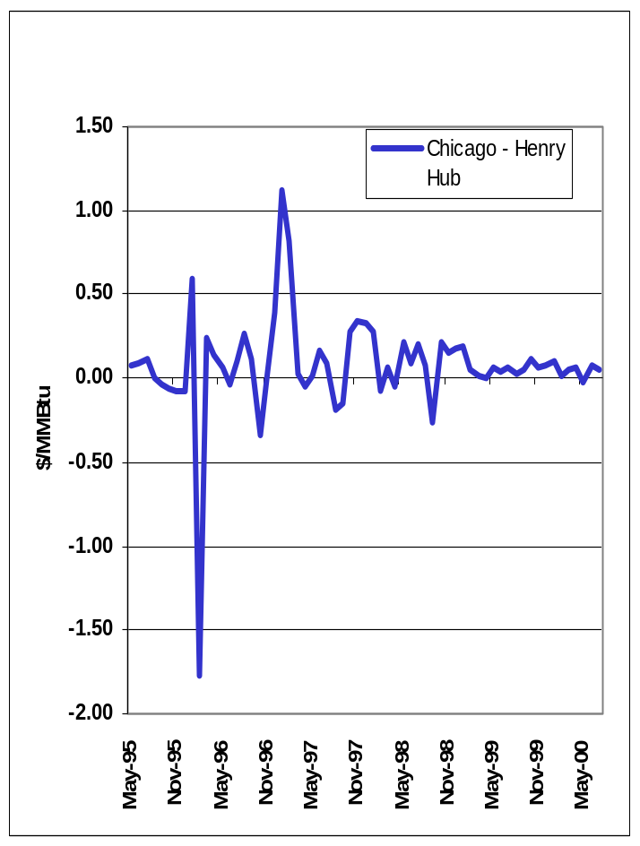
Chicago - Henry Hub basis could go negative part of the year
Positive Henry Hub - Midwest basis could move northeast of Chicago during the non- heating season and Chicago - Henry Hub basis could become negative in the summer
Midwest could reverse flow 600 - 800 MMcfd to Tennessee

Slide 10
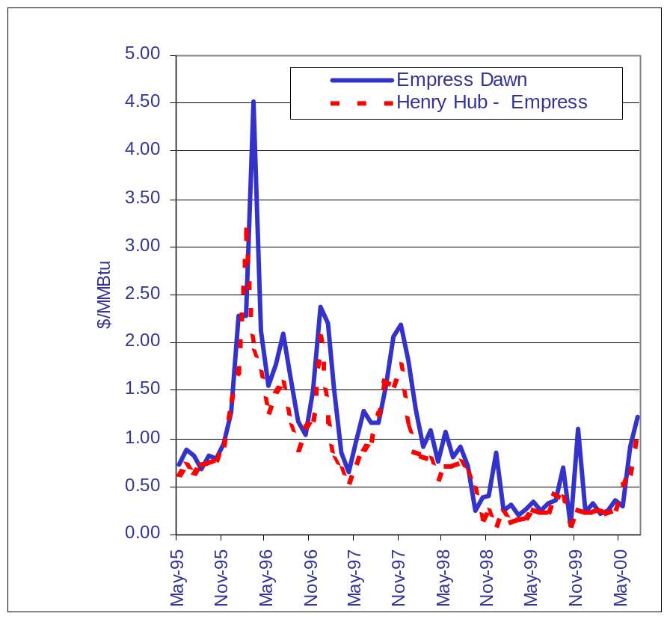
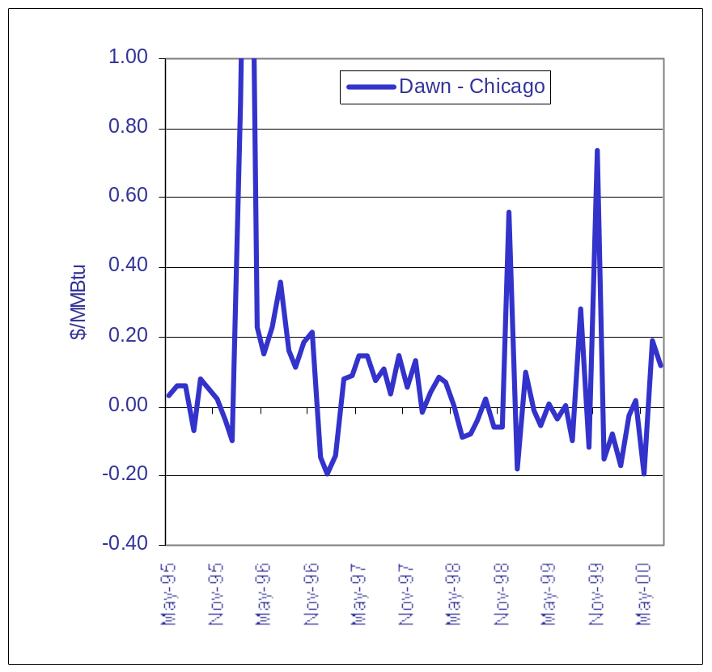
Dawn - Chicago basis will depend a great deal on Alberta - Henry Hub basis

Slide 11
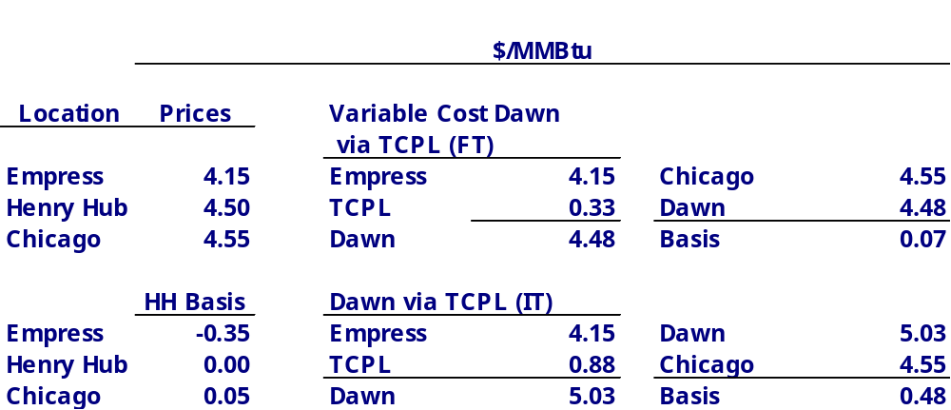
De-contracting on TCPL and 80% IT floor will widen Chicago - Dawn basis

Slide 12
The addition of Vector is likely to create excess capacity to Eastern Canada
Vector will add 700 MMcfd from Joliet, Illinois to Dawn, Ontario with near term expansion of 1 Bcfd
Weather normalized Eastern Canadian demand is about 3.4 Bcfd and growing at 1.5% to 2.0% per year (50 to 70 MMcfd).
It would take almost ten years to absorb this capacity on Eastern Canada
Either there must be substantial growth, gas must be exported, or delivered en-route

Slide 13
Eastern Canadian Capacity is used at a high load factor
Bcfd
Capacity
Flows
Utilization
TCPL/GLGT
5.34
5.16
97%
Others
1.05
0.07
7%
Total
6.39
5.24
82%
Export
Niagara
0.84
0.81
97%
Iroquois
0.81
0.70
87%
Other
0.94
0.31
33%
Total
2.59
1.83
71%
Net Eastern Canada
3.80
3.41
90%

Slide 14
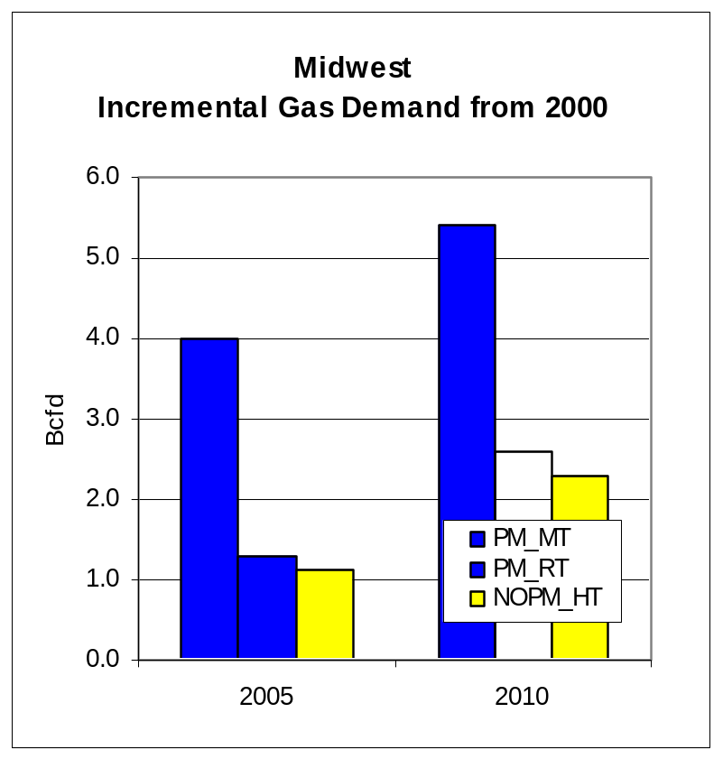
Power Generation is the big upside for gas demand
Loss of 4375 MW nuclear capacity in Ontario could support gas demand growth 180 - 360 MMcfd
Proposed gas combined cycle plants in Ontario equal 3.2 GW about 720 MMcfd at 90% capacity
Environmental regulations put 9.4 GW of coal at risk in Michigan

Slide 15
US Northeast market growth is not likely to absorb all the proposed pipeline capacity
CAPACITY
PROJECT
(
MMCFD)
DATE
Distrigas
220
June 1999
M&N
440
Dec 1999
Independence
900
Nov 2001
Millennium
700
Nov 2002
Scotian Shelf
900
2005
Total
3160

Slide 16
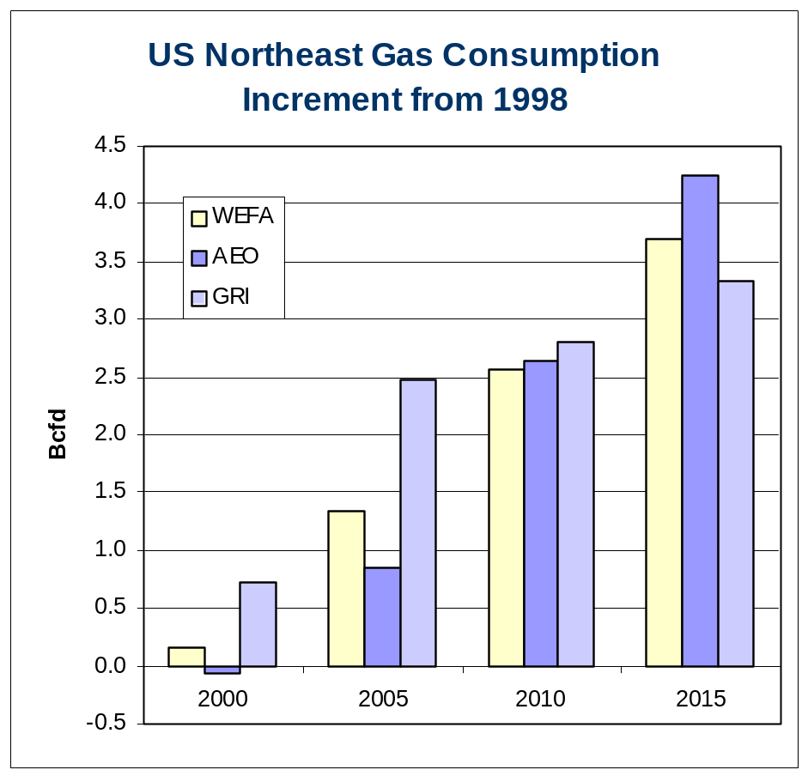
3.16 Bcfd of additional capacity compare to .8 to 2.4 Bcfd of consumption growth by 2005
Weather normalized Northeast 2000 consumption 8.4 Bcfd
WEFA’s forecast calls for a 2.6% growth rate over the next decade
1000 MW Nuclear Unit is about 250 MMcfd
1% increase in electricity demand 100 MMcfd per year

Slide 17
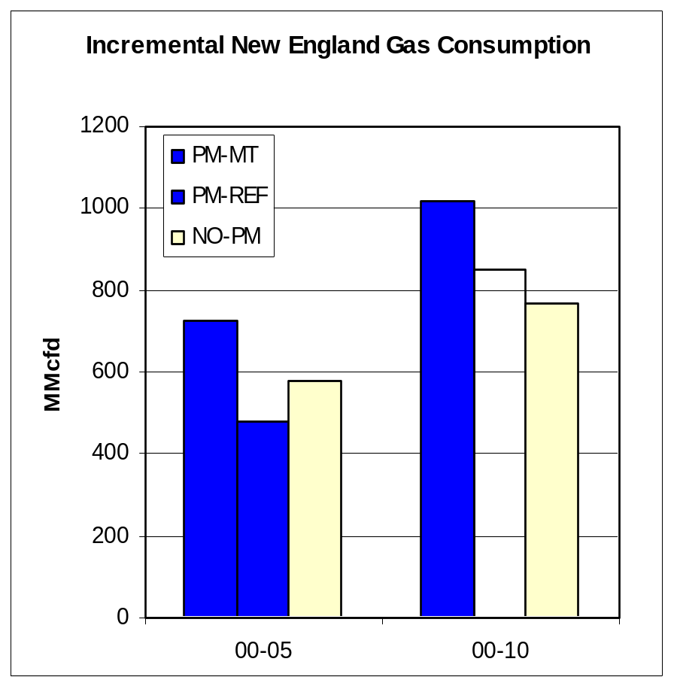
Potential Capacity Additions to the New England Market Are Huge Compared to the Market Size
1998 Capacity to New England was 2.7 Bcfd and weather normalized consumption about 1.8 Bcfd (68% capacity utilization)
Capacity additions Distrigas and M&N 640 MMcfd
Another 900 MMcfd from Scotian Shelf
50% increase in pipeline capacity over next five years

Slide 18
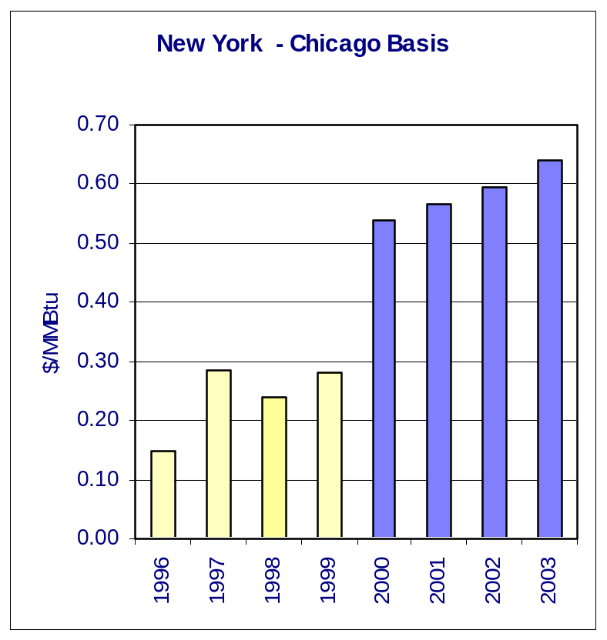
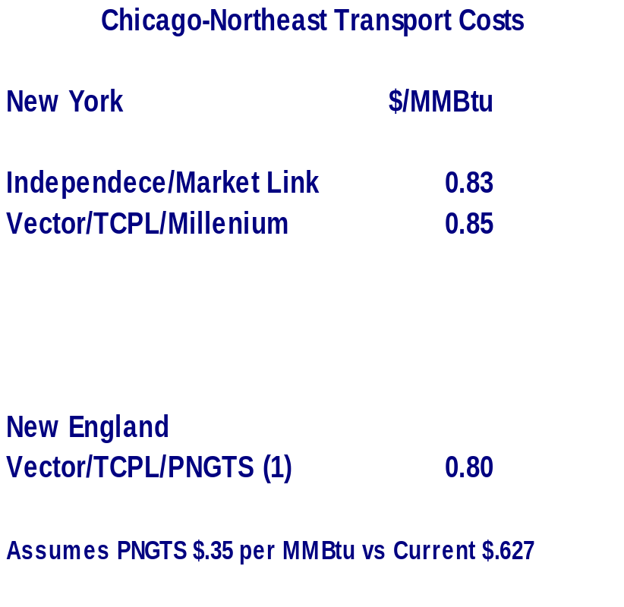
Most likely Northeast can absorb one major project by 2003 (near term - basis will increase substantially with normal winter)

Slide 19

Atlanta ▪ Boston ▪ Chicago ▪ Los Angeles
New York ▪ Philadelphia ▪ Washington, DC
Brussels ▪ Frankfurt ▪ London ▪ Mexico City
Milan ▪ Ottawa ▪ Paris ▪ Pretoria ▪ Toronto
Atlanta ▪ Boston ▪ Chicago ▪ Los Angeles
New York ▪ Philadelphia ▪ Washington, DC
Brussels ▪ Frankfurt ▪ London ▪ Mexico City
Milan ▪ Ottawa ▪ Paris ▪ Pretoria ▪ Toronto

